Slide 1
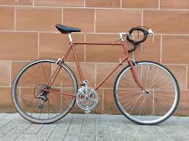
Adventure Works Sales Analysis
Data Analyst Internship Program- ExcelR
Date: 30 /3/2026
Group - 3

Slide 2
Business Objective
To analyze historical sales data and identify trends and patterns in customer purchasing behavior
To determine the most profitable products, regions, and customer segments
To support business decision-making by providing data-driven insights
To identify opportunities for increasing revenue and reducing operational costs
To improve overall sales performance by targeting high-value customers

Slide 3

About the Company
Adventure Works Cycles is a multinational manufacturing company specializing in bicycles and related accessories
The company operates across North America, Europe, and Asia, serving a diverse customer base
Manufacturing operations include a key plant in Mexico that produces critical subcomponents
Final product assembly is carried out in Bothell, Washington
The company aims to expand its market share and improve profitability through better sales strategies

Slide 4
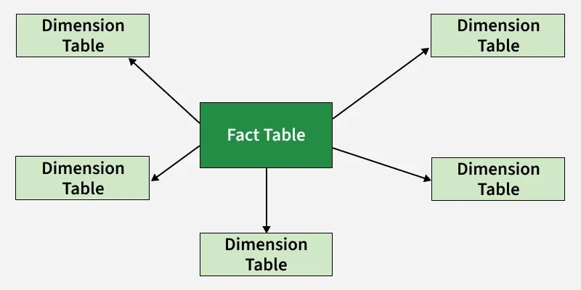
Data Model
A Star Schema data model was implemented for efficient data organization and analysis
The central fact table (Sales) contains transactional data such as order quantity, price, and discount
Dimension tables provide descriptive attributes:
Product Dimension: product details and pricing
Customer Dimension: customer information
Date Dimension: time-based attributes
Sales Territory Dimension: regional data
This model improves query performance and simplifies reporting

Slide 5
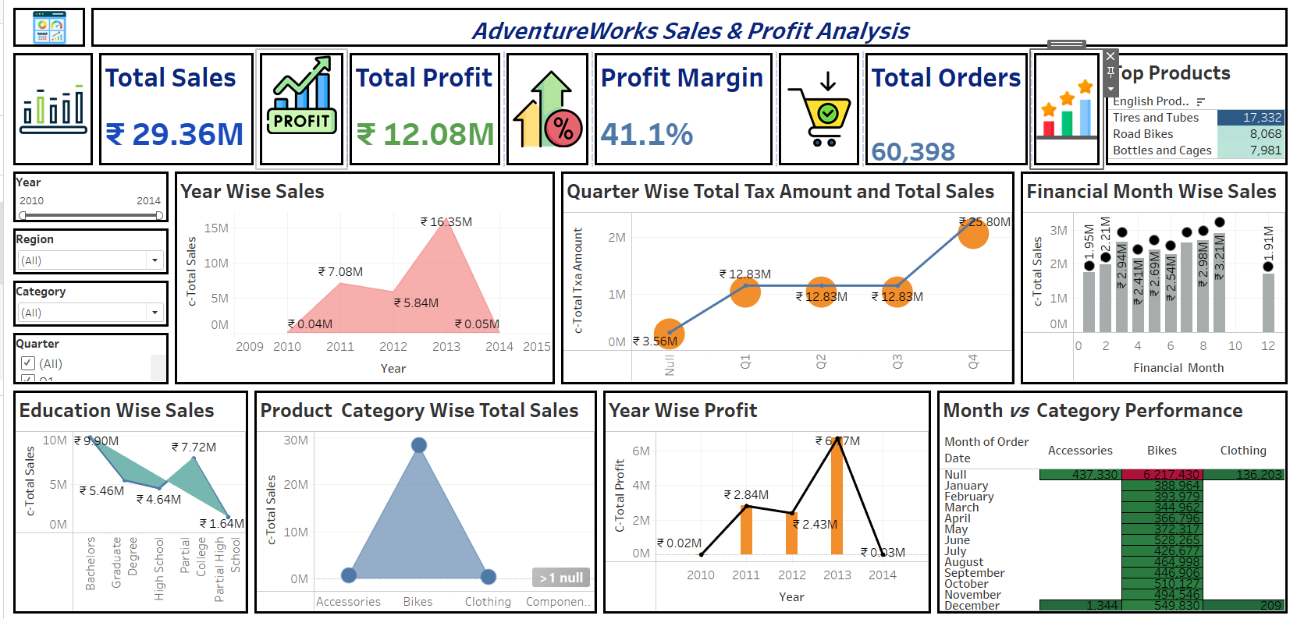
TABLEAU DASHBOARD

Slide 6
Data Model
This dashboard provides a comprehensive overview of sales, profit, and business performance for Adventure Works
It integrates multiple KPIs and visualizations to enable data-driven decision-making
The dashboard is designed to be interactive, allowing users to filter data by Year, Region, Category, and Quarter
It highlights key business metrics such as Total Sales, Total Profit, Profit Margin, and Total Orders
Visualizations are structured to show trends, comparisons, and distributions across different dimensions
It enables stakeholders to quickly identify top-performing products, regions, and time periods
The dashboard supports analysis at multiple levels including yearly, quarterly, monthly, and category-wise performance
It helps in identifying profitability trends and cost efficiency
Designed with a clean layout to ensure easy interpretation and quick insights

Slide 7
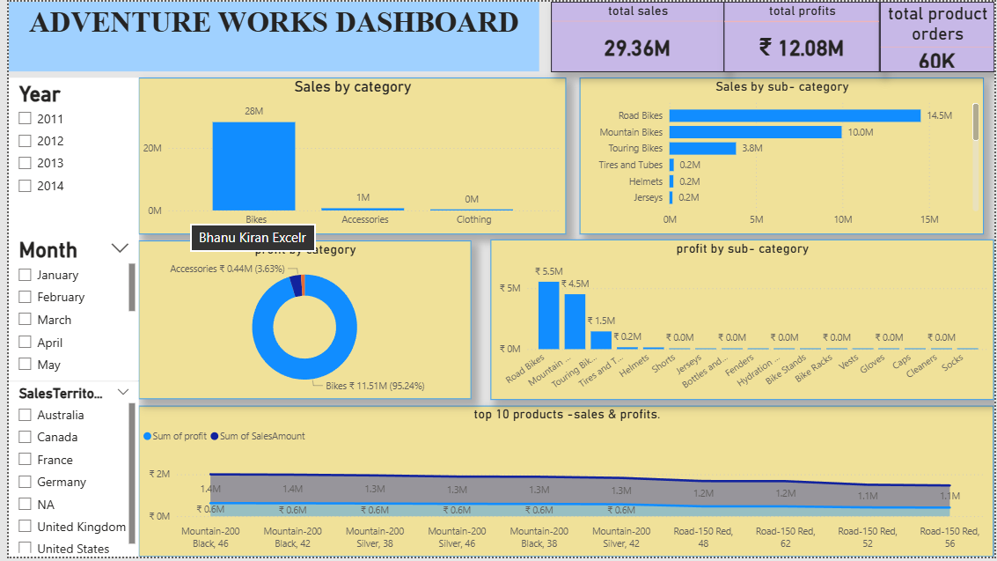
POWER BI DASHBOARD

Slide 8
This dashboard focuses on analyzing sales and profit performance across product categories and sub-categories
It provides a detailed breakdown of revenue contribution from different product segments
The dashboard includes key KPIs such as Total Sales, Total Profit, and Total Orders for quick performance evaluation
It enables users to filter data dynamically using Year, Month, and Sales Territory filters
Visualizations highlight top-performing products, category-wise contribution, and profitability trends
It helps identify high-revenue and high-profit products, supporting better business decisions
The dashboard is designed to provide clear insights into product-level performance and sales distribution
It supports data-driven strategies for product management, marketing, and inventory planning

Slide 9
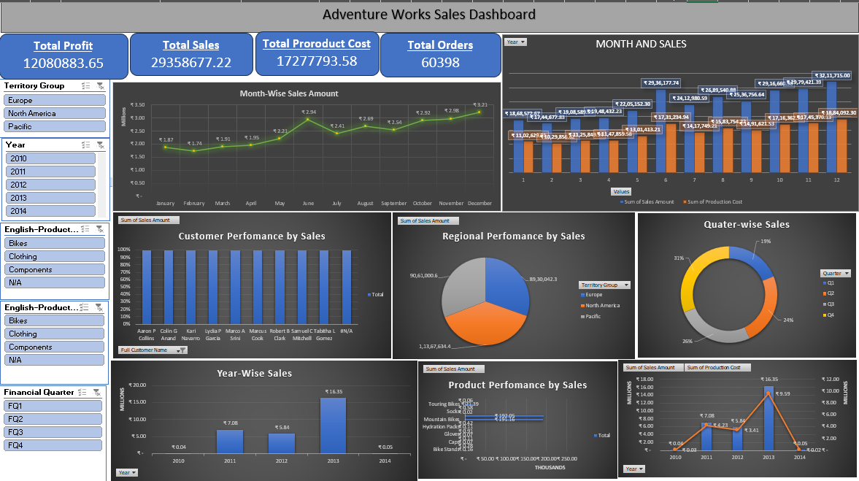
EXCEL DASHBOARD

Slide 10
This dashboard provides a comprehensive and interactive analysis of sales, profit, and cost performance across multiple dimensions
It is designed to give a 360-degree view of business operations, including time trends, regional performance, customer insights, and product analysis
The dashboard integrates key performance indicators (KPIs) such as Total Sales, Total Profit, Total Product Cost, and Total Orders
It enables users to explore data dynamically using filters like Year, Territory Group, Product Category, and Financial Quarter
Multiple visualizations are used to highlight trends, comparisons, and distributions
The dashboard supports data-driven decision-making by identifying high-performing areas and improvement opportunities
It provides insights into sales growth, cost efficiency, and profitability trends
The layout is designed to ensure clarity, usability, and quick interpretation of key metrics

Slide 11
ANALYSIS
EDUCATION-WISE SALES
Bachelor’s degree holders contribute the most
Lower contribution from partial high school segmeNT
📊 OVERALL KPIS
Total Sales: ₹29.36M
Total Profit: ₹12.08M
Profit Margin: 41.1%
Total Orders: 60,398
🛍️ PRODUCT ANALYSIS
Top Products
Tires and Tubes (highest sales)
Road Bikes
Bottles and Cages
CATEGORY-WISE SALES
Bikes dominate revenue contribution
Accessories and Clothing contribute less
👥 CUSTOMER & DEMOGRAPHICS
Customer Performance
Sales are evenly distributed among customers (no extreme dependency)
🌍REGIONAL PERFORMANCE
Top Region: North America
Followed by Europe and Pacific
Fairly balanced but North America slightly dominates

Slide 12
ANALYSIS
MONTH-WISE SALES
SALES GRADUALLY INCREASE THROUGH THE YEAR
PEAK IN OCT–DEC
LOWEST IN JAN–FEB
QUARTER-WISE SALES
Q4 CONTRIBUTES THE HIGHEST (~31%)
Q1 IS THE LOWEST (~19%)
📅 TIME-BASED ANALYSIS
Year-wise Sales
2010: Very low (~₹0.04M)
2011–2012: Gradual growth (~₹7.08M → ₹5.84M)
2013: Peak (~₹16.35M)
2014: Sharp drop (~₹0.05M)
PROFIT TRENDS
PROFIT PEAKS IN 2013 (~₹6–7M)
DECLINES SHARPLY IN 2014
PROFIT CLOSELY FOLLOWS SALES TREND
📈 TAX VS SALES
TAX INCREASES PROPORTIONALLY WITH SALES
HIGHEST IN Q4

Slide 13
SUGGESTIONS
📈 Growth Strategy
Expand high-performing products (Bikes, Tires & Tubes)
Introduce bundles (Bike + Accessories)
🌍 Regional Expansion
Invest more in:
Europe
Pacific regions
Use targeted marketing campaigns
🔍 DATA/BUSINESS INVESTIGATION
Analyze 2014 drop:
Missing data?
Operational issues?
Market changes?
📅 SEASONAL OPTIMIZATION
Increase inventory before Q4
Run promotions in Q1 to reduce slump
🛍️ PRODUCT STRATEGY
Diversify beyond bikes to reduce dependency
Boost low-performing categories (Clothing, Accessories)
👥 CUSTOMER STRATEGY
Loyalty programs for repeat customers
Personalized marketing based on buying behavior
💰 PROFIT OPTIMIZATION
Maintain pricing strategy (already strong margin)
Optimize production cost further

Slide 14
CONCLUSION
The business experienced rapid growth until 2013, driven mainly by bike sales.
Profitability is strong, with a high margin of 41%.
Sales are seasonal, peaking in Q4.
North America leads, but other regions show potential.
A sharp drop in 2014 needs investigation.
Product portfolio is heavily dependent on bikes, which is both a strength and a risk.

